Slide 1
Confronting the opioid crisis: An overview of Washington state
Elizabeth Perez, MPH
Chief of Public Affairs and Equity, DOH
Latino Health Forum
12/5/24

Slide 2
Background
Overdose deaths due to opioids are a serious public health crisis in the United States. In the past, this crisis was driven by the use of heroin and prescription opioids. More recently, however, this crisis has been driven by synthetic opioids such as fentanyl.
Overdose deaths from both prescription and illicit opioids have increased over the past few decades, where over 980,000 people have died from them nationwide in the last 15 years. That's about 180 people per day.
Washington State has a rate of overdose death higher than the national average. From 2009-2023, we saw that over 21,000 Washington residents died from a drug overdose. 71% of those deaths involved an opioid.
Notes:
National data (source: CDC Wonder).
For the past 15 years (2009 to 2023) there have been 985,675 drug overdose deaths, roughly 180 (179.9) people per day.
Note: National 2023 data is preliminary and might change.
While in the past, this crisis was driven by the use of heroin and prescription opioids, it is currently driven by potent synthetic opioids, mainly fentanyl
WA Data: (2009 to 2023) there have been 21,709 Washington residents died of a drug overdose death.
70.8% of these drug overdose deaths involved an opioid drug.

Slide 3
Proportion of Drug Types Involved in Overdose Deaths, 2023
When looking at our 2023 Washington State data, we see that out of 3,456 confirmed overdose deaths in 2023, 81% of deaths involved an opioid, mainly fentanyl.
Source: WA DOH death certificates
Notes:
Any opioid is the main takeaway, but we suspect the synthetic opioid surge is primarily fentanyl based.
Synthetic opioids are predominately fentanyl and fentanyl analogs.

Slide 4
The Importance of Language
People turn to opioids for a variety of reasons, including curiosity, pain management, mental health coping, and pleasure. To effectively address substance use, it’s crucial to understand and tackle these underlying motivations.
Unfortunately, conversations about drug use often carry a stigmatizing tone, using language that paints individuals who use drugs in a negative light. This stigma from communities or healthcare providers can lead to a reluctance to seek essential support and services.
Every person deserves empathy and respect, regardless of their circumstances.
While many view substance use through the lens of the disease model, it’s important to acknowledge that not everyone sees their experience as a disease.
The disease model tends to describe a chronic and deteriorating condition, which may not resonate with everyone's unique experience with drug use. Recognizing this diversity in experiences can lead to more effective support and understanding.
Notes:
stateofwa.sharepoint.com/sites/DOH-PCH-IDEA/Shared Documents/Forms/AllItems.aspx?id=%2Fsites%2FDOH-PCH-IDEA%2FShared Documents%2FEquitable Language Guide - Final %281%29%2Epdf&parent=%2Fsites%2FDOH-PCH-IDEA%2FShared Documents

Slide 5
The Importance of Language Cont’d
**Physical Dependence**
Any opioid, when used over a significant period, will inevitably lead to physical dependence. This means that individuals who stop using these substances will experience withdrawal symptoms, which can be both uncomfortable and distressing.
It is crucial to understand that physical dependence is not the same as substance use disorder; the former relates to physical withdrawal, while the latter involves psychological and behavioral components impacting a person’s relationship with the drug.
**Substance Use and Substance Use Disorder**
Not every instance of substance use signals a disorder, but a substance use disorder is defined by health complications, disabilities, and significant disruptions in a person’s life.
Addiction is the most severe form of substance use disorder and should be recognized as a critical clinical diagnosis that demands professional attention.
It is essential to recognize that substance use exists on a spectrum, and the majority of individuals who use drugs do not go on to develop a substance use disorder or addiction.
Opioid use disorder specifically targets those who misuse opioids. While not all opioid users will develop this disorder, the reality is that they remain at a significant risk for potentially fatal overdoses.
Notes:
stateofwa.sharepoint.com/sites/DOH-PCH-IDEA/Shared Documents/Forms/AllItems.aspx?id=%2Fsites%2FDOH-PCH-IDEA%2FShared Documents%2FEquitable Language Guide - Final %2
81%29%2Epdf&parent=%2Fsites%2FDOH-PCH-IDEA%2FShared Documents
Physical Dependence
Any opioid when taken over time can result in physical dependence, where the person experiences withdrawal symptoms once they stop using the substance.
Physical dependence is distinct from substance use disorder, which is psychological.
Substance Use & Substance Use Disorder
Not all substance use is disordered use. A substance use disorder results in health problems, disability, and disruption of one’s life.
Addiction is the most severe form of substance use disorder, and it is an actual diagnosis.
There is a spectrum of substance use, and most people who use drugs do not develop a substance use disorder or an addiction.
Opioid use disorder is a type of substance use disorder involving opioids. Not all people who use opioids have opioid use disorder, however, they are still at risk for overdose

Slide 6
The Importance of Data
We can make better plans for how to reduce overdose deaths if we understand who is most affected by opioids and why.
Drug overdose and opioid prescription data help us see trends and differences between demographic groups. This allows us to identify if communities are at a disproportionate risk.
Recently, a demographic shift has been observed in the epidemic with dramatic increases in opioid misuse and overdose deaths among Hispanic/Latino, African American, and American Indian/Alaska Native populations.
Notes:
pep20-05-02-002.pdf

Slide 7
Drug Overdose Death Rates by Sex Among Washington Residents
*2023 data are not finalized and may change,
Source: WA DOH death certificates
Notes:
Male identifying individuals are at a higher risk
These again are for all WA residents, not just the Hispanic/Latino population. We don’t have specific data for that population with filters on sex.

Slide 8
Drug Overdose Death Rates by Race/Ethnicity Among Washington Residents
AIAN: American Indian/Alaskan Native
NH/PI: Native Hawaiian and Pacific Islander NH: Non-Hispanic
NH: Non-Hispanic
Source: WA DOH death certificates
Notes:
Looking at the rate of deaths across all WA residents – how many were in each category. But we know it is a bit muddier than this, as there may be overlap between multi-racial individuals.

Slide 9
Drug Overdose Death Rates by Race/Ethnicity
Comparing 2020, 2021, 2022 and 2023
AIAN: American Indian Alaskan Native
NH/PI: Native Hawaiian and Pacific Islander
Source: WA DOH death certificates
* Counts 10 to 16-rates unstable.
Notes:
The increase in the overdose death rate for the Hispanic population in 2023 (compared to 2022) was higher than: American Indian/Alaskan Natives Non-hispanic, White Non-Hispanic, NH/PI-Non-Hispanic, and Asian-Non-Hispanics.
The drug overdose death rate among Hispanic Washington residents surpassed the rate among White, non-hispanics in 2023.

Slide 10
Drug Overdose Death Rates Among Hispanics Washington Residents
Source: WA DOH death certificates
Notes:
The drug overdose death rate among Hispanic Washington residents by age, comparing the change from 2017-2019 and 2021-2023.
This can show at what age groups we are seeing increases among the Hispanic population.

Slide 11
Why are we seeing increasing trends for opioid misuse and opioid overdose deaths within Hispanic/Latino communities? This may be due to….
Occupational exposures, such as military service, construction and agricultural work, increase the risk for injury and pain medication prescription.
Mental health conditions such as anxiety, depression, and PTSD have a strong overlap with substance use. Discrimination and trauma can contribute to many of these mental health conditions.
Language barriers/lack of culturally competent care, including the lack of consistent bilingual providers and health-related materials in one’s native language, contribute to issues with prevention, treatment, and recovery strategies.
Lack of resources such as income and health insurance can cause the need for self-pain management (illicit).
Documentation status can cause concerns for seeking care or calling 911.
Stigma, misperceptions, and negative narratives about substance use. Increased criminalization due to disproportionate policing and potential fear of immigration enforcement – leading to not seeking care.
Notes:
These are some examples of potential factors from the national level. It’s likely that there are more reasons than just these listed, and there is likely not just one reason alone – it could be a mix of other factors.
Other potential factors include:
Drug supply potency increasing over the last few years, its not necessarily that more people are using but more are dying due to the increased potency.
BIPOC communities tend to be targeted and more frequently incarcerated, their tolerance decreases when they are incarcerated and they have higher tendencies to overdose upon release.
https://store.samhsa.gov/sites/default/files/pep20-05-02-002.pdf

Slide 12
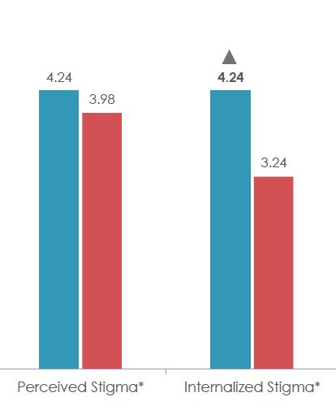
Stigma
In a 2023 survey done by the DOH, it was found that Spanish speakers had higher rates of perceived stigma and internalized stigma when it comes to using opioids.
Perceived stigma – how they believe others see them and their substance use (most people do not believe I am worth their time/resources because of my opioid use)
Internalized stigma – how they see themselves and their substance use (I think less of myself because of my opioid use)
This could imply Spanish speakers are less likely to disclose and seek help, out of fear of judgement from others and increased judgement towards themselves.

Slide 13
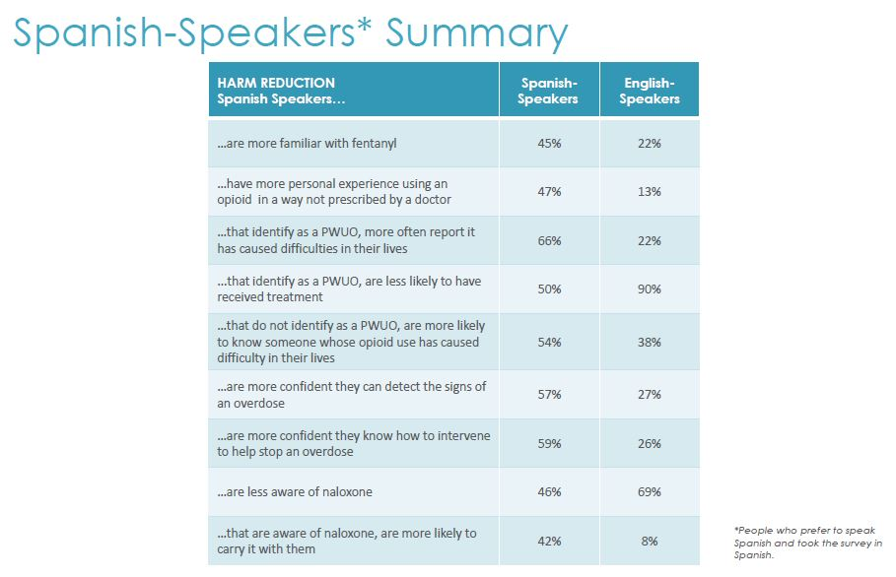
Knowledge & Awareness
In the same 2023 survey done by the DOH, knowledge and awareness for opioids was also evaluated.
We notice that Spanish speakers are more likely to use opioids in a way that was not prescribed by a doctor, but they also are less likely to get proper care.
This also highlights that it is not so much a knowledge issue – but primarily stigma and systemic barriers.
Notes:
The Hispanic/Latino population is more likely to use but also less likely to get proper care
Its not so much a familiarity/knowledge issue within this community, it’s primarily stigma and other systemic barriers to accessing care

Slide 14
Socio-Cultural Factors Associated with Accessing Treatment
Fear of discrimination and past experiences of discrimination
Stigma, misperceptions, and negative narratives
Barriers to accessing bilingual treatment programs
Fear of speaking to government agencies or those who report to government agencies
Liability concerns with administering naloxone or trying to provide aid in an overdose situation
Socio-economic-lack of health care coverage to help pay for treatment
Less stable community support – moving locations frequently could cause interruptions in care
Understanding spirituality and faith and its role in the community
Familismo-Understanding the social network and the importance of family
We are not monolithic-”Hidden Hispanic”
Notes:
Opioid and Illicit Drug Use Among the Hispanic/Latino Populations | SAMHSA
Once again the caveat is that this is based off more national data– again these are just some potential barriers, there could be more than these listed and likely its not just one reason alone.

Slide 15
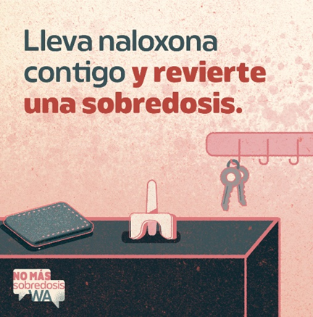
What DOH is Doing to Help Address This
Increasing access to harm reduction services
Naloxone distribution, syringe services, risk reduction counseling, etc.
Provider training to increase familiarity and comfort with prescribing medications for opioid use disorder
Developing partnerships to create culturally and linguistically appropriate overdose education and naloxone distribution outreach
NoMasSobredosisWA.org campaign
2023 campaign focused on promoting carrying naloxone
WA State Opioid and Overdose Response (SOOR) Plan:
Prevent opioid misuse
Identify and treat substance use disorder
Ensure and improve the health and wellness of individuals who use drugs
Use data to detect opioid misuse/abuse, monitor illness, injury, and death, and evaluate interventions.
Support individuals in recovery
https://www.hca.wa.gov/assets/program/WashingtonStateOpioidandOverdoseResponsePlan-final-2021.pdf

Slide 16
Notes:
This video is the Spanish transcreation, but could change to English if that is your preference.
English video: https://www.youtube.com/watch?v=SxsfJma5thA

Slide 17
Questions?

Slide 18
Elizabeth Perez
Chief of Public Affairs and Equity
Executive Office of Public Affairs and Equity (OPAE)
Elizabeth.perez@doh.wa.gov
LinkedIn: https://www.linkedin.com/in/elizabeth-perez

Slide 19
To request this document in another format, call 1-800-525-0127. Deaf or hard of
hearing customers, please call 711 (Washington Relay) or email civil.rights@doh.wa.gov.

